Slide 1
Downloading data using APIs

Slide 2
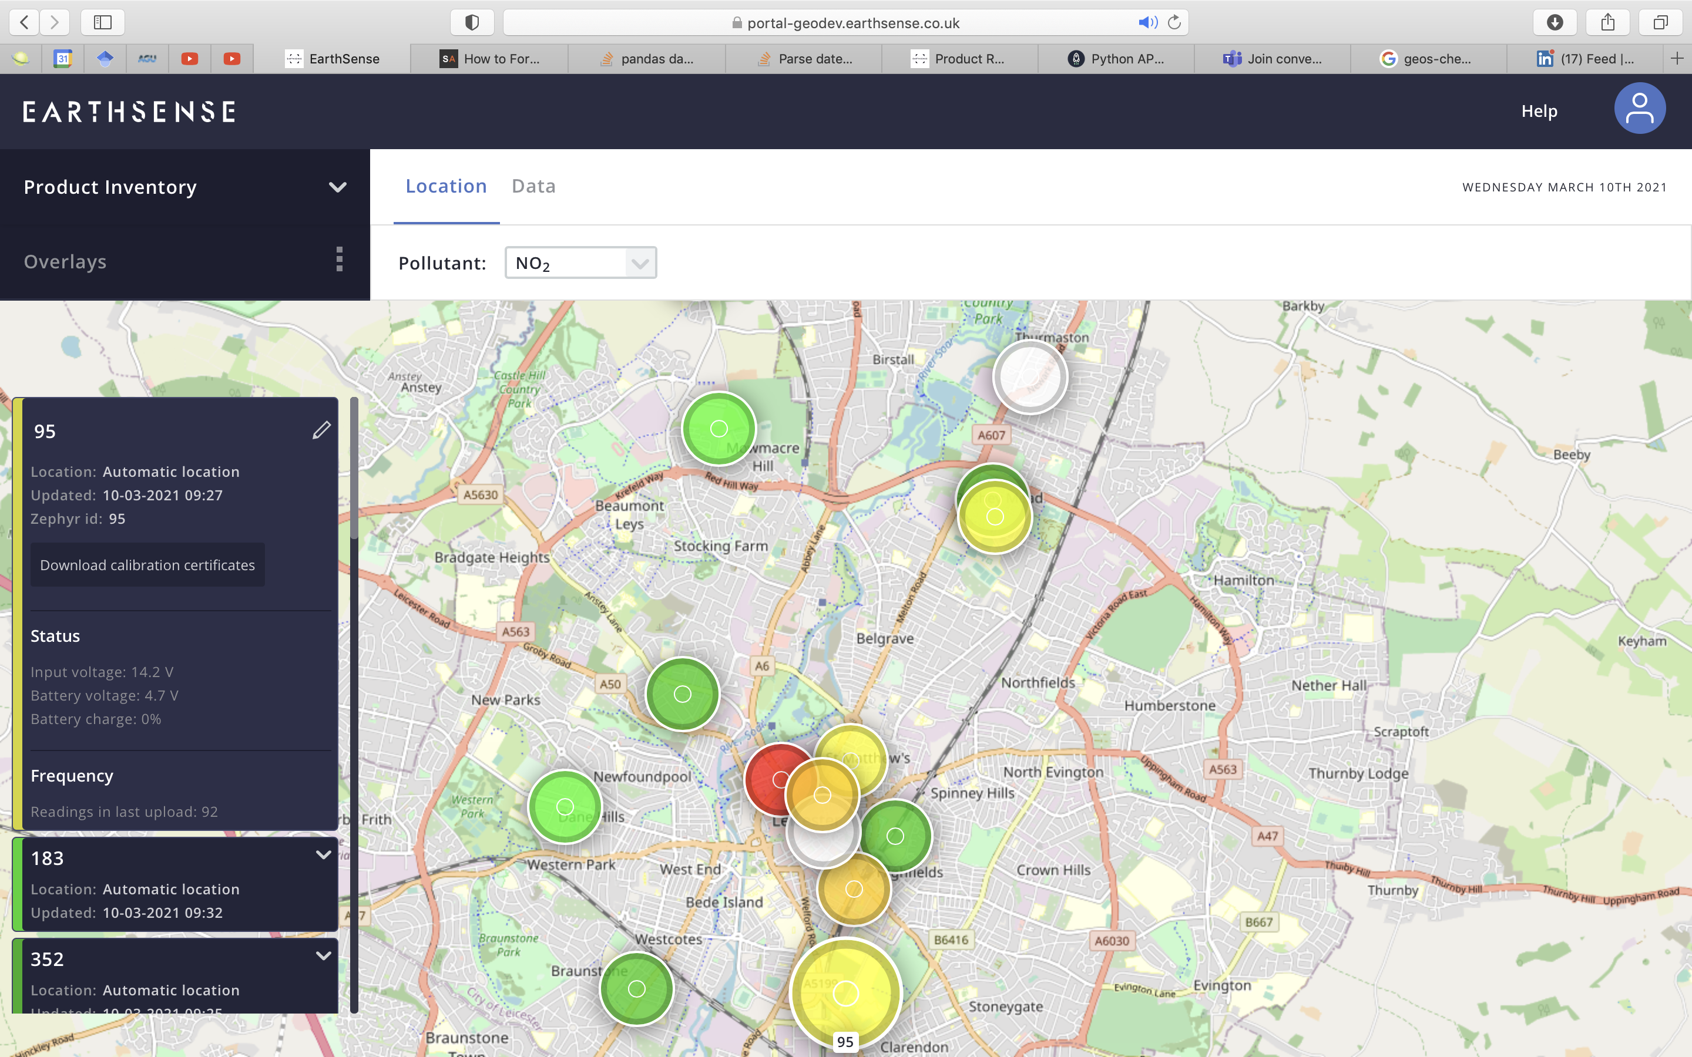
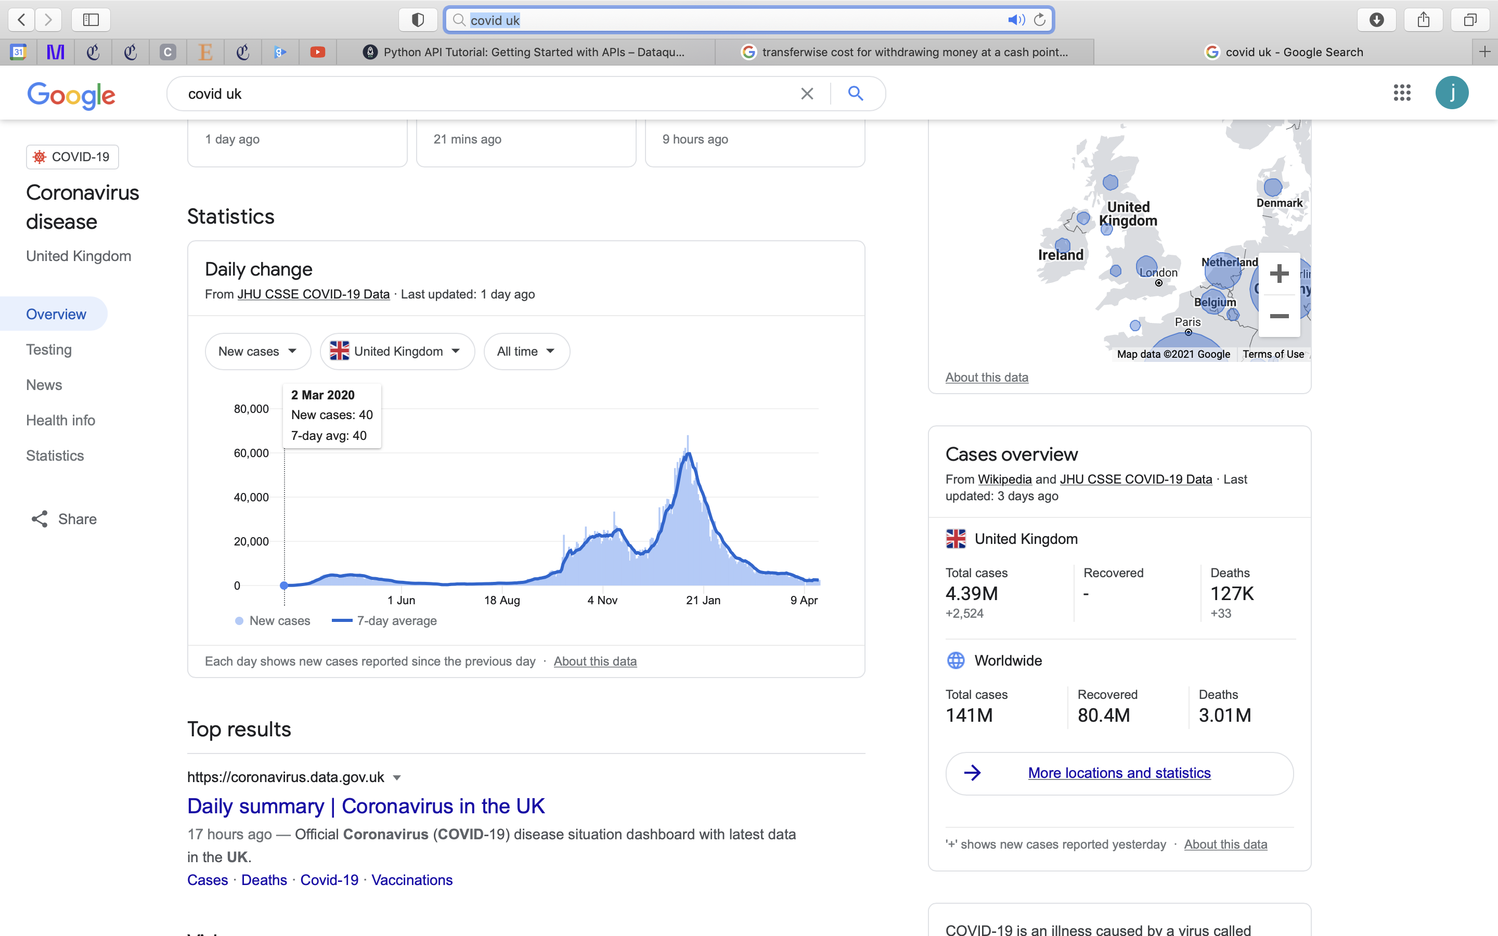
APIs provide access to data
Greater control of what portion of the data you are retrieving
The data to too large to download from the website
To use live information (a database that is constantly be updated)

Slide 3
Resources
https://www.dataquest.io/blog/python-api-tutorial/
Required Python packages and how to install them
example APIs
How to manipulate the resulting data (JSON, yuck!)

Slide 4
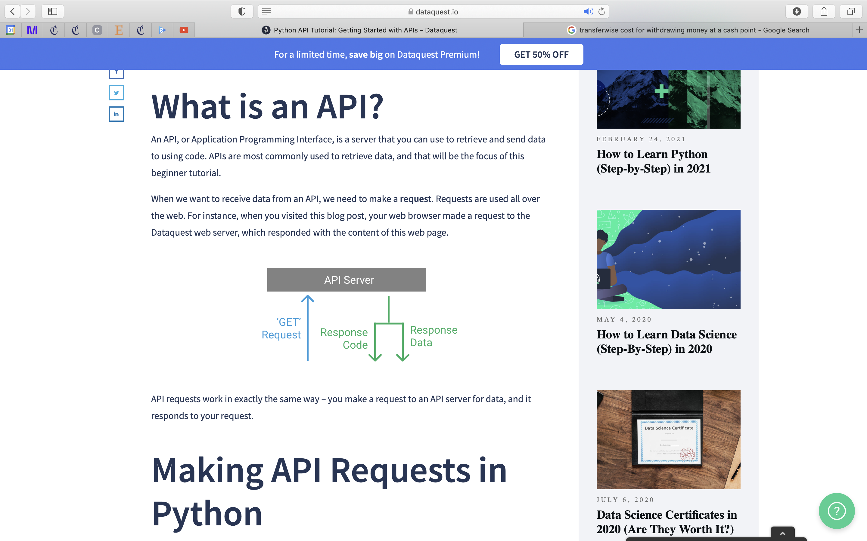
Python script

Slide 5
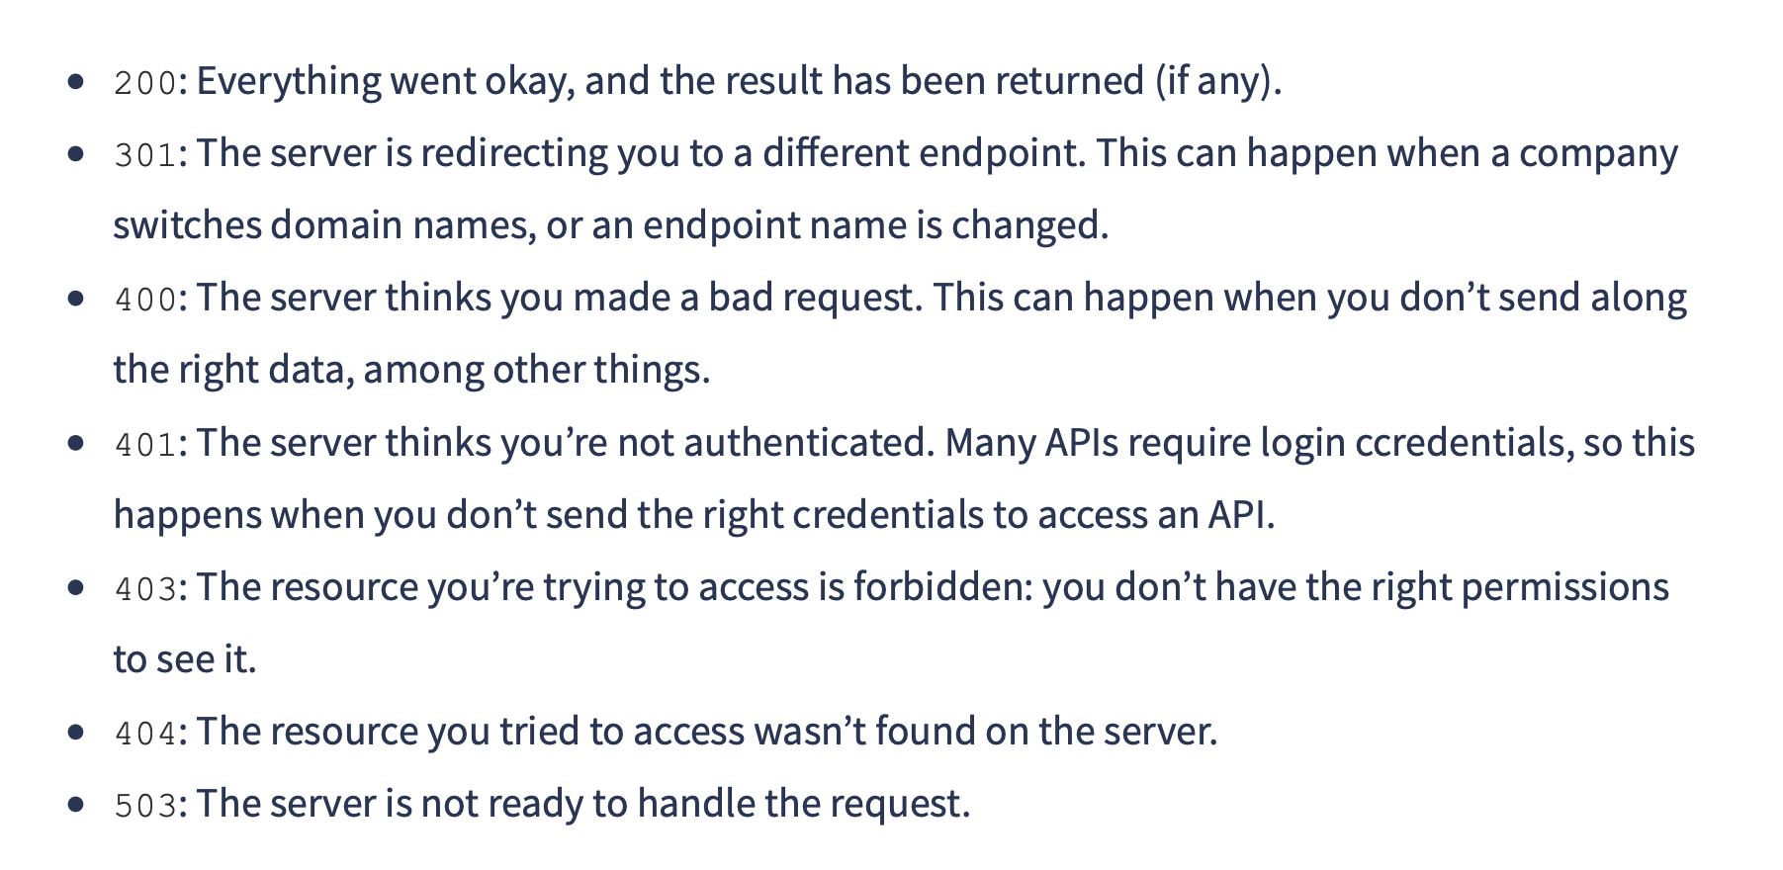
API Status Codes (response codes)
Be careful, they work for the example APIs used in the tutorial here, but could not be relied on when I used an API from an air pollution database

Slide 6
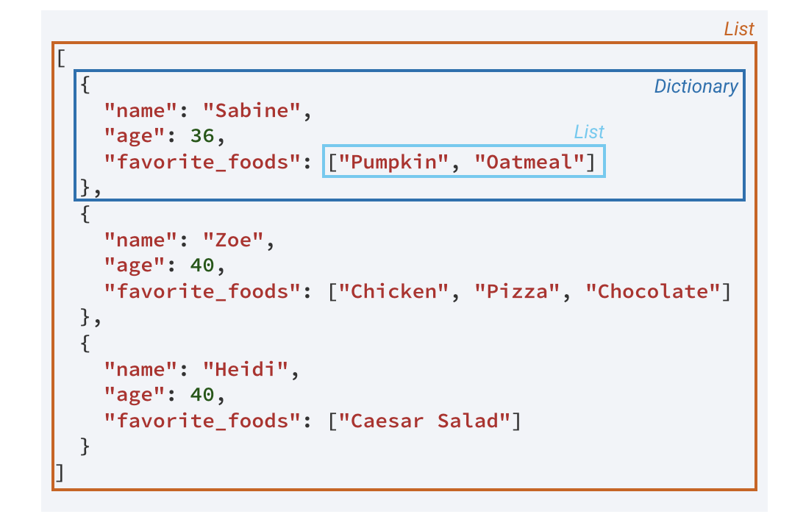
JavaScript Object Notation (JSON) data (response data)
JSON is the language of the API (a requests for data returns the data in this format/labguage)
JASON is a way to encode data structures that ensures that they are easily readable by machines.
But difficult to work with (for me!)
Use the Python package, ‘json’, to convert the JSON to a more familiar object
Working with JSON was difficult for me, and the structure of the data was not consistent – across different APIs, as well as within the same API (but for different time periods)
def jprint(obj):
# create a formatted string of the Python JSON object
text = json.dumps(obj, sort_keys=True, indent=4)
print(text)

Slide 7
Example API in the tutorial…

Slide 8
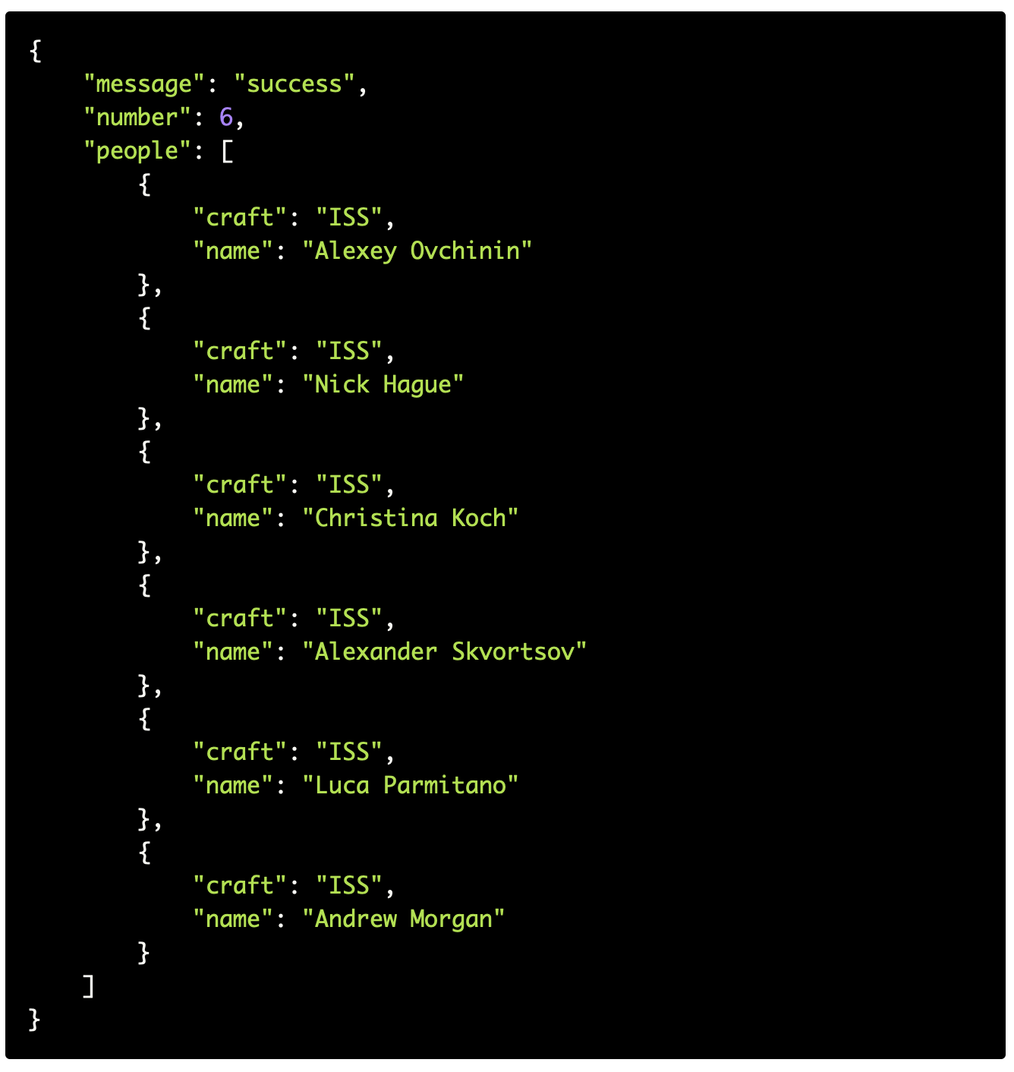
Response data (JSON format)
jprint(respone)
'message': 'success', 'number': 7, 'people': [{'craft': 'ISS', 'name': 'Sergey Ryzhikov'}, {'craft': 'ISS', 'name': 'Kate Rubins'}, {'craft': 'ISS', 'name': 'Sergey Kud-Sverchkov'}, {'craft': 'ISS', 'name': 'Mike Hopkins'}, {'craft': 'ISS', 'name': 'Victor Glover'}, {'craft': 'ISS', 'name': 'Shannon Walker'}, {'craft': 'ISS', 'name': 'Soichi Noguchi'}]}
Response data (in the form of a string)
API Server
Python script
JavaScript Object Notation
Retrieve data
endpoint
response = requests.get("http://api.opennotify.org/astros.json")
Notes:
No query parameters

Slide 9
Next example API in the tutorial introduces an API that uses a query parameter
- With these, you can have more control of what data you are requesting (e.g. time, location, pollutants, etc.)

Slide 10
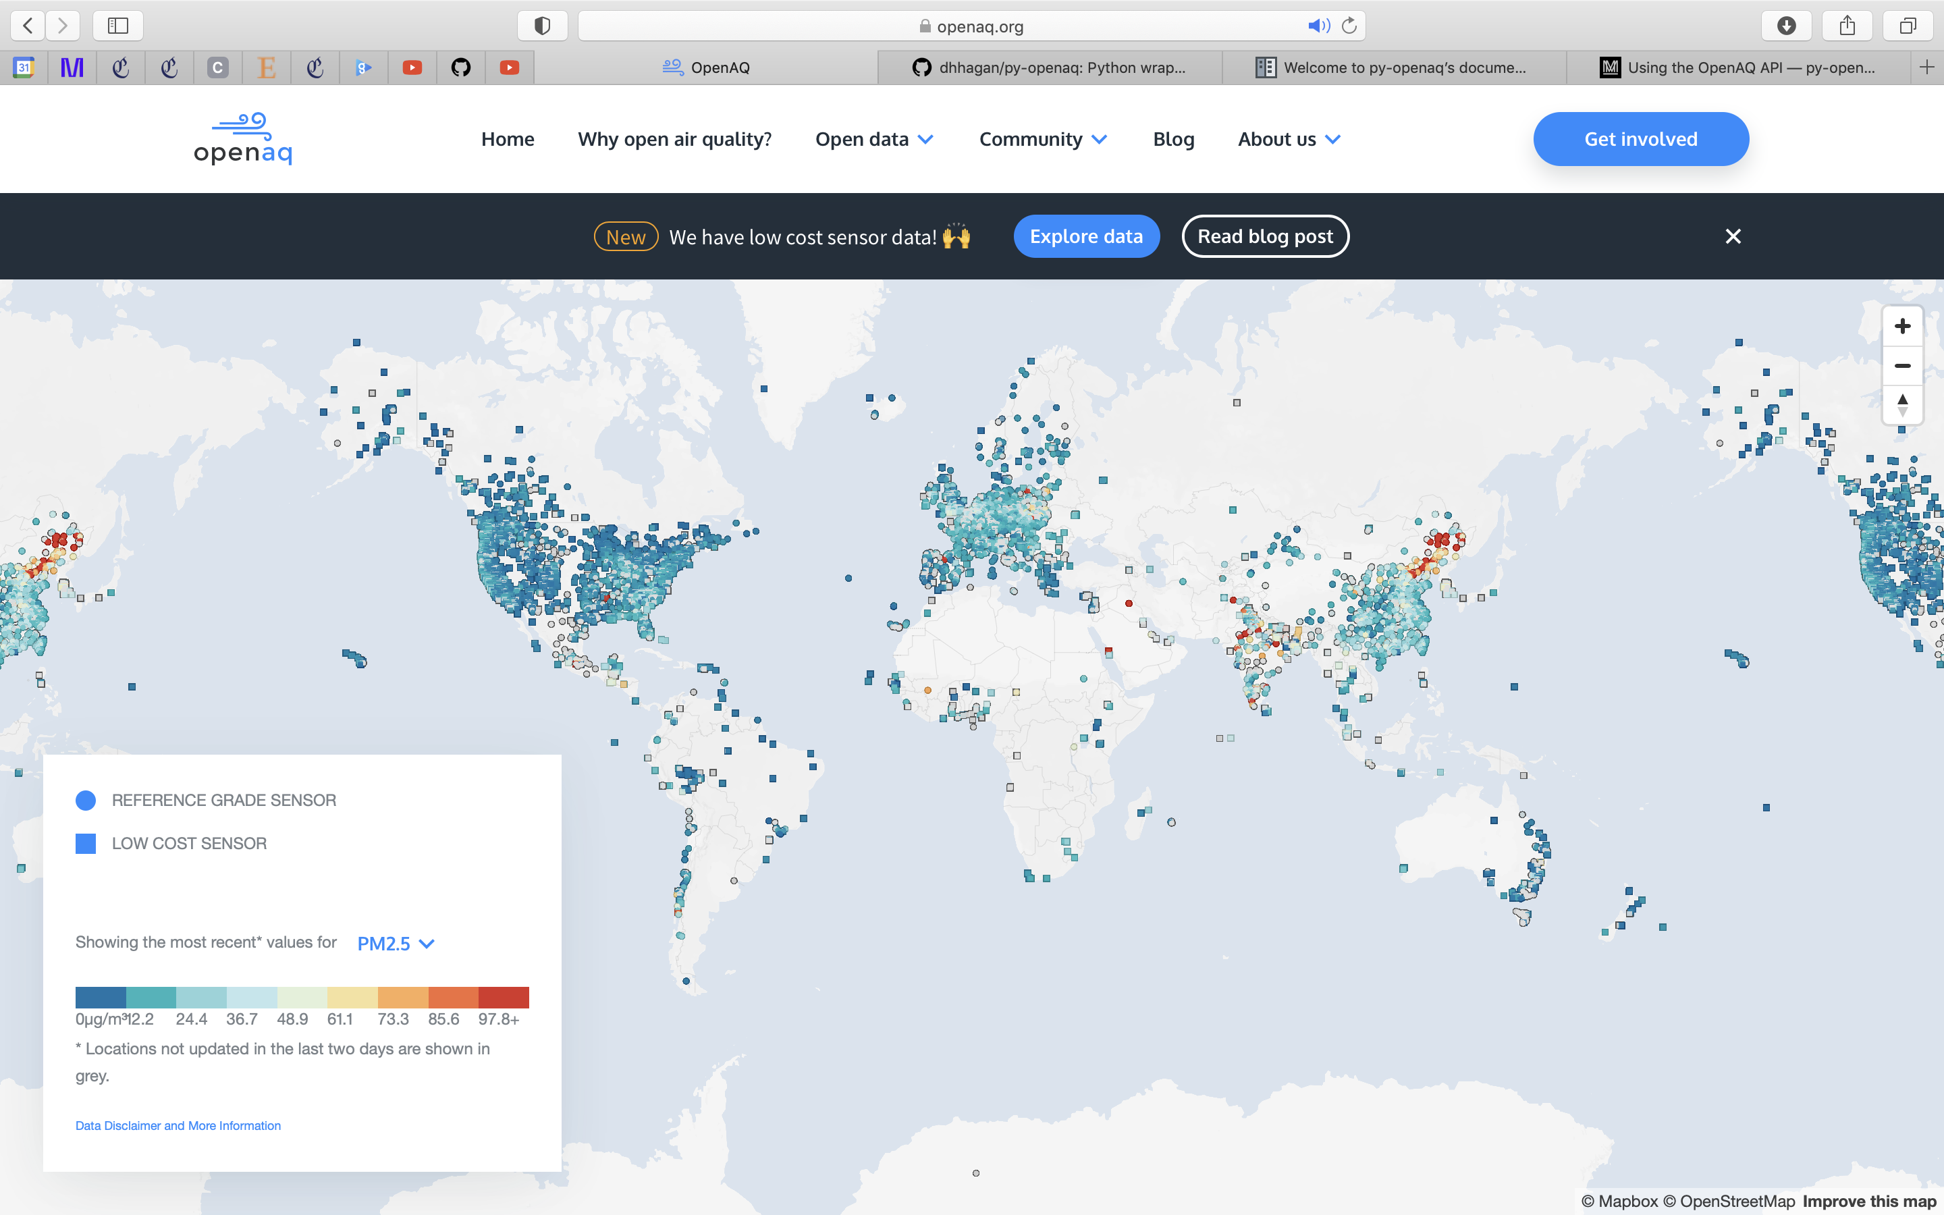
Open AQ – A publicly available database of sensors around the world
Info on Open AQ website on their own APIs is NOT USEFUL
I found a nice Python wrapper, developed by David Hagan (w/ tutorial), which was much more useful
One huge advantage to this package is that it loads in the form of Panda DataFrame, which is much more easier to handle that JSON
http://dhhagan.github.io/py-openaq/tutorial/api.html
https://py-openaq.readthedocs.io/en/latest/

Slide 11
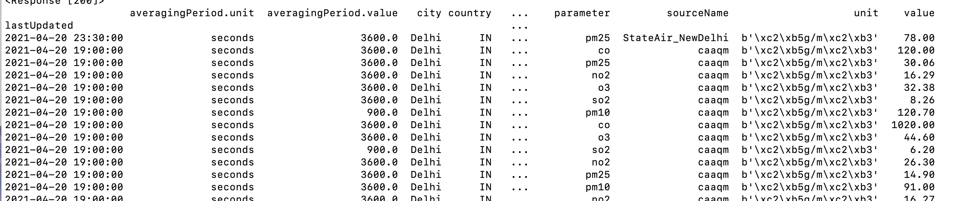
data = api.latest(city='Delhi', parameter='pm25', df=True)
data = api.measurements(city='Delhi', parameter='pm25', limit=60000, df=True)

Slide 12
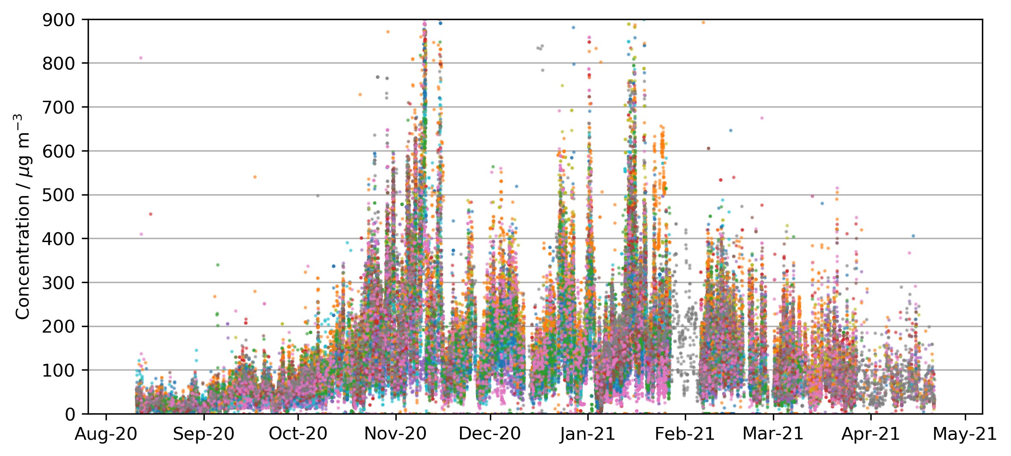
PM_{2.5} over Delhi from OpenAQ Sensor Network
Average conc of 150 (over 104,022 datapoints)

